Slide 1

Excel is a world-class premium performing end-to-end infrastructure solution – designed, manufactured, supported and delivered – without compromise.

Slide 2



A Brief History
2006 | EU Launch
2007 | MEA Launch
2012 | Brand Refresh Lead supplier for London Olympics
2013 | UK #1 Copper Supplier – 19% Market Share
2014 | Environ Launch
2015 | Excelerator Launch
2016 | Enbeam Fibre Launch
2019 | First in the industry to supply product in plastic free packaging Enbeam PON Solution Launch
2020 | UK #1 Cabling Supplier – 21% Market Share Enbeam FTTx Solution Launch New Excel website launched
2023 | UK #1 Cabling Supplier – 26% Market Share UAE #2 Cabling Supplier – 16% Market Share
2024 | New Excel Partner Portal Launch
When
1997
Why
To create sustainable, managed and profitable foundation from which to grow the business
How
6 to 9 months sourcing, brand creation – name, logo, collateral, staff training and ‘buy in’

Slide 3
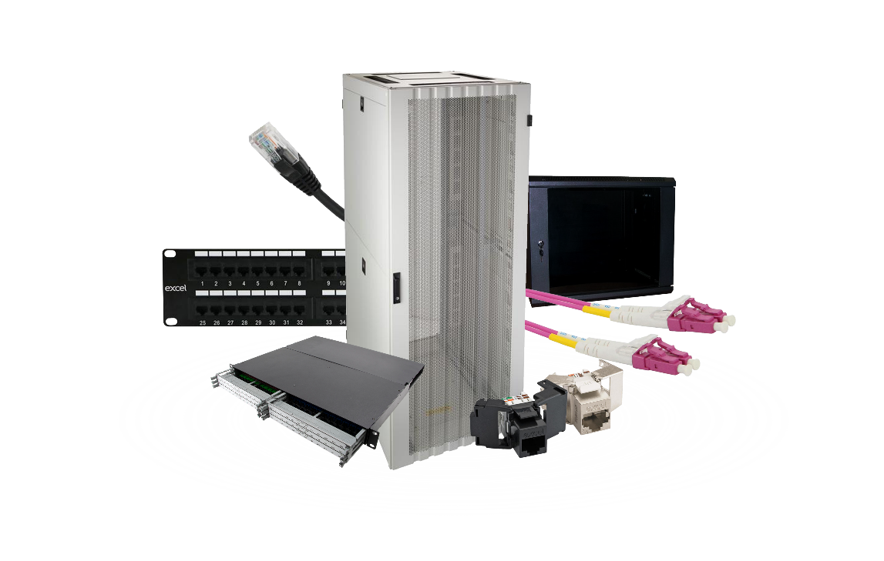
Key Facts
£139M
3727
100%
Sales in 2023
Products
CPR-Compliant
25
1495
212
Year Systems and Applications Warranty
Excel Partners
Tonnes of plastic removed since 2019

Slide 4



Supply Chain Capability
DISTRIBUTORS
AZERBAIJAN
DENMARK
EGYPT
ESTONIA
FINLAND
FRANCE
GERMANY
HUNGARY
ICELAND
IRELAND
ISRAEL
ITALY
LATVIA
LITHUANIA
MALTA
NETHERLANDS
NORWAY
POLAND
PORTUGAL
QATAR
ROMANIA
SAUDI ARABIA
SPAIN
SWEDEN
SWITZERLAND
UKRAINE
UAE
UK

Slide 5


Market Leader
26
%
Excel’s share
of the UK
market
The Number One Cabling Brand in the UK Market
According to BSRIA Research

Slide 6







Brand Values
Accepted
Reliable
Compatible
Flexible
Proven
Available

Slide 7


Third Party Verification
Manufacturer
Component testing
Products tested individually
Lab
Channel testing
Products tested as a channel

Slide 8
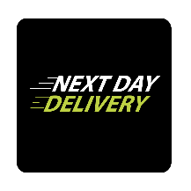











Why Choose Excel?
Large Stock Holding | Free Next Day Delivery (UK) | Extensive Product Range | Quality Assurance Programme | Personalised Data Sheets | Market Acceptance
Plastic Free Packaging | CPR-Compliant as standard | Third Party Channel and Component Verification | 25-Year Warranty available | Environmentally Conscious | Dedicated Account Manager

Slide 9
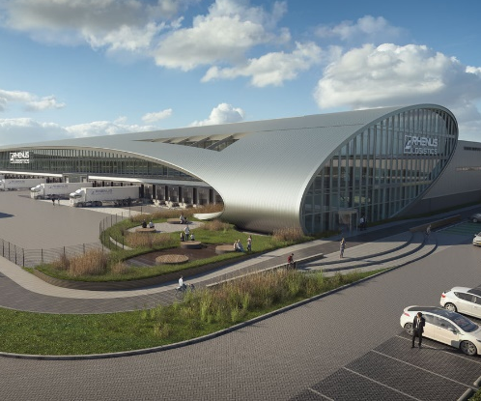


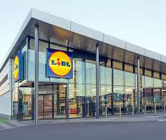

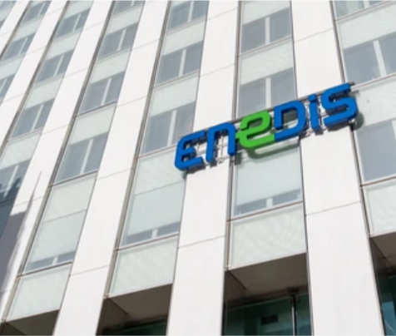

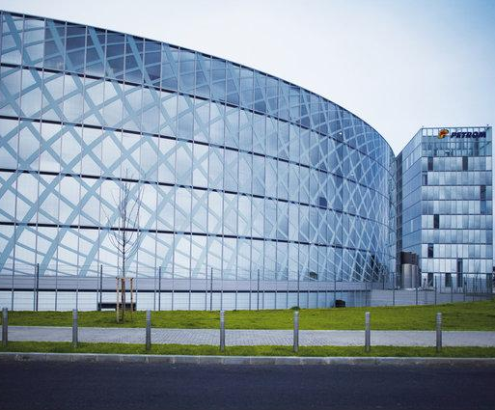
Key Customers - Europe
The Tube (New Logic III) The Netherlands | Warsaw Unit Poland | Biotope France | LIDL Spain
HUS Children’s Hospital Finland | Enedis France | Guardia Civil Spain | OMV Petrom Romania

Slide 10
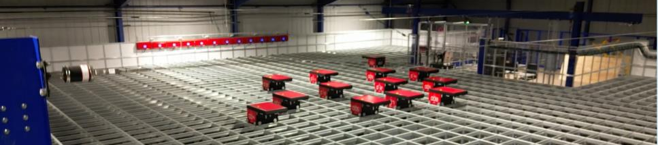
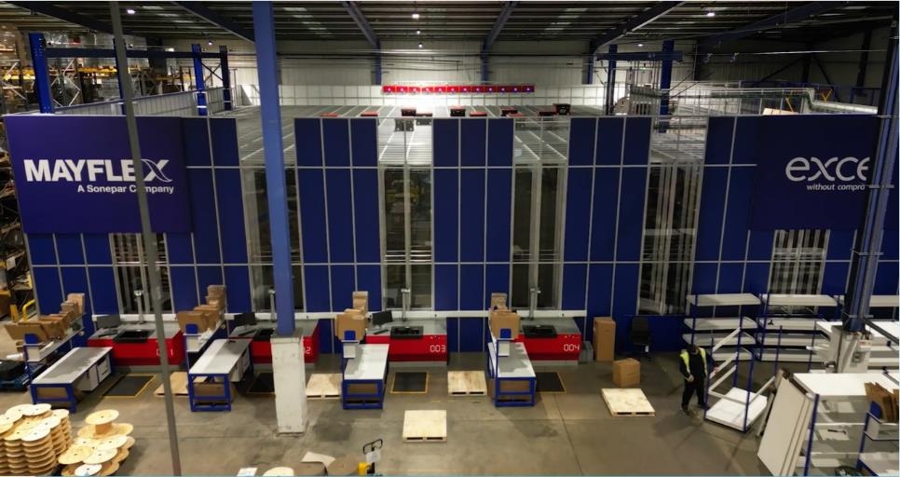
Automation - Autostore
14 Maybot Robots
Enhanced service levels
Improved accuracy
Quicker to process orders
Better consolidation of orders – fewer consignments
Reduced outer box sizes
Crash lock boxes – remove the need for tape
More energy efficient
Watch the Maybots in action

Slide 11
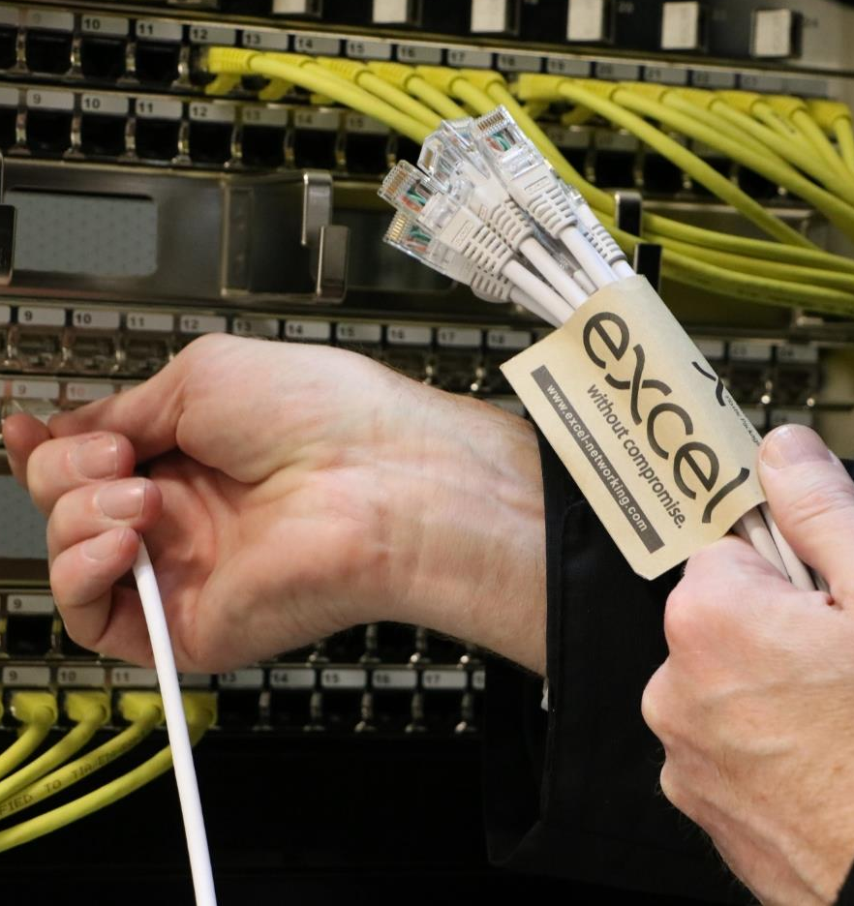

SUSTAINABILITY

Slide 12
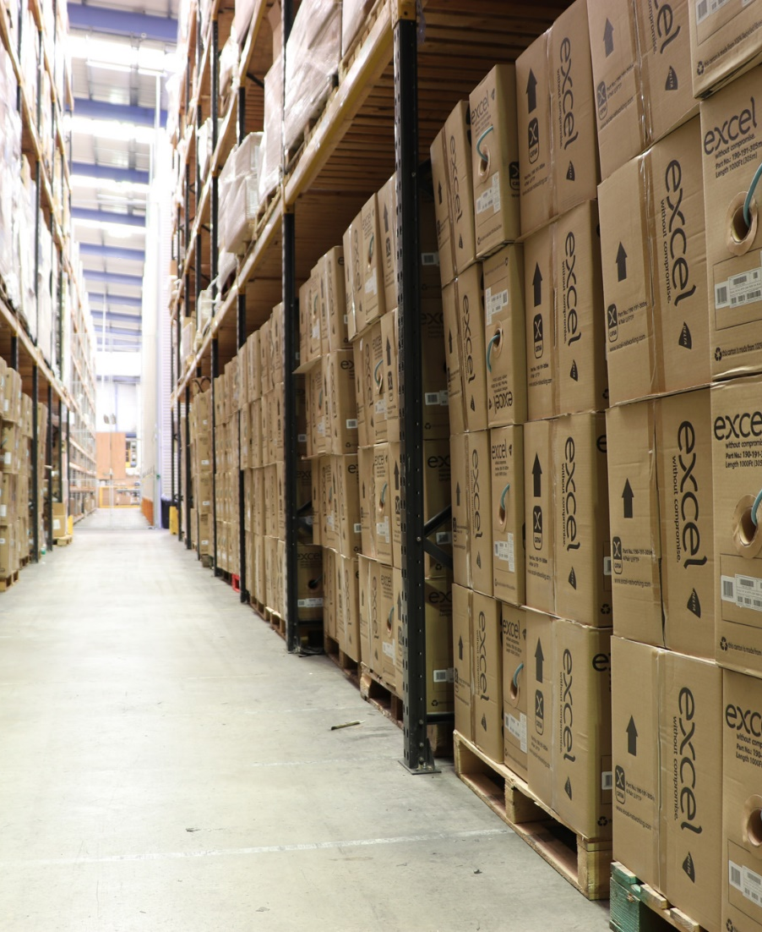
Our Approach to Sustainability
We use LED lighting throughout our offices and warehousing helping to reduce the amount of electricity used – saving 150kwh per working day and 200kwh at the weekends/public holidays.
We monitor our energy consumption through an Energy Management System (EMS) and we have a team of associates focused on continually improving our stats.
We encourage all our company car drivers to drive electric cars and we have charging points located at our HQ and Environ warehouse in Birmingham.
We care about our local community and all associates are given a day to dedicate to volunteering each year.
We have a Silver rating with Ecovadis

Slide 13
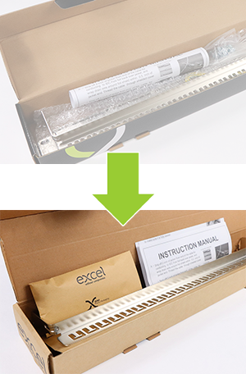
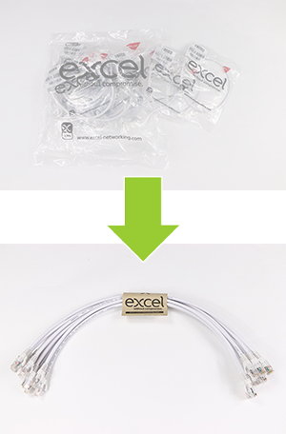
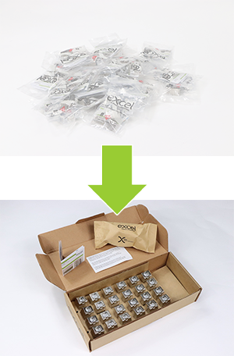
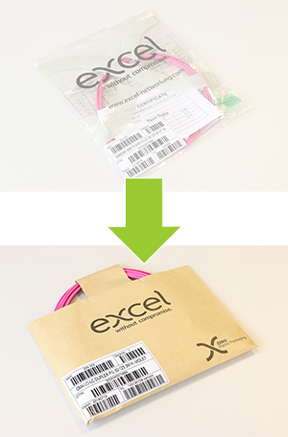
Zero Plastic Packaging
Click here to view our videos about Excel and Sustainability on Youtube

Slide 14
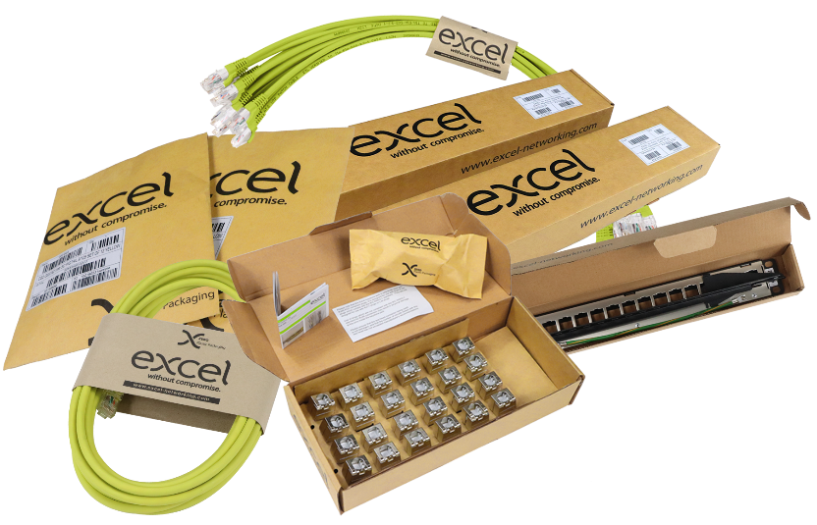
Excel and Sustainability
Since 2019 we have saved 85M plastic bags (212 tonnes) of single use plastic from entering the supply chain and into landfill.
Excel packaging is made from recyclable materials and is 100% recyclable.
We have online configurators to show how much plastic you will save from choosing Excel.
We collect empty cable drums and re-use them wherever possible – so far this has seen a reduction of 50,542kgs of plywood and 83 tonnes of CO2.
All our waste is recycled – some of which is re-purposed and made into ‘packaging void fill’.
Environ racks are wrapped and shipped in palletwrap that is manufactured from 30% recycled film and is 100% recyclable rather than being virgin film.
For orders over 8 pallets, we can deliver on gas powered trucks which results in a saving of 85% in CO2 emissions.

Slide 15




Excel Partner Programme

Slide 16










Partner Programme: Benefits
Partner Benefits
Onsite toolbox training (ESP)
25-year warranties
Site audits
(ESP)
Post sales support
Preferential pricing
Excellence initiative – training credits
Sales training
Pre sales support
Personalised products

Slide 17








Partner Programme: Requirements
Annual revenue commitment
Promote the Excel brand
Partner Requirements
Complete a 12-month business plan (ESP)
Offer complementary IP Converged solutions
(ESP)
Retain qualified Excel engineers
Share project pipeline opportunities
(ESP)
Attend training courses & briefings

Slide 18
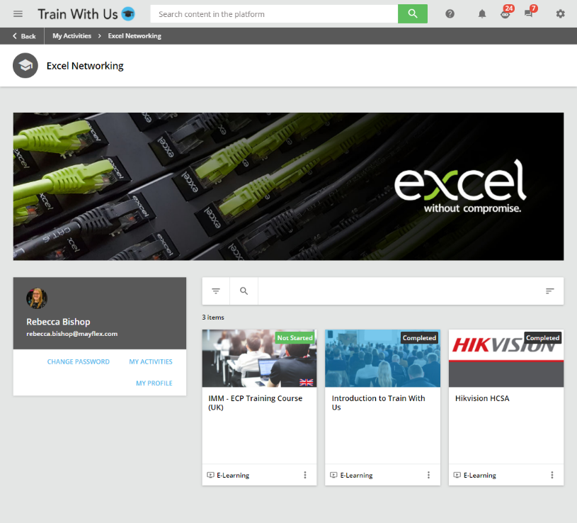


Partner Programme: Training
Dedicated e-Learning platform to support your training requirements
  Updates and reminders via email
  Personal learning dashboard
  Modular courses
  Easy access to your certificates
  Automatic reminders to renew your Partner status

Slide 19
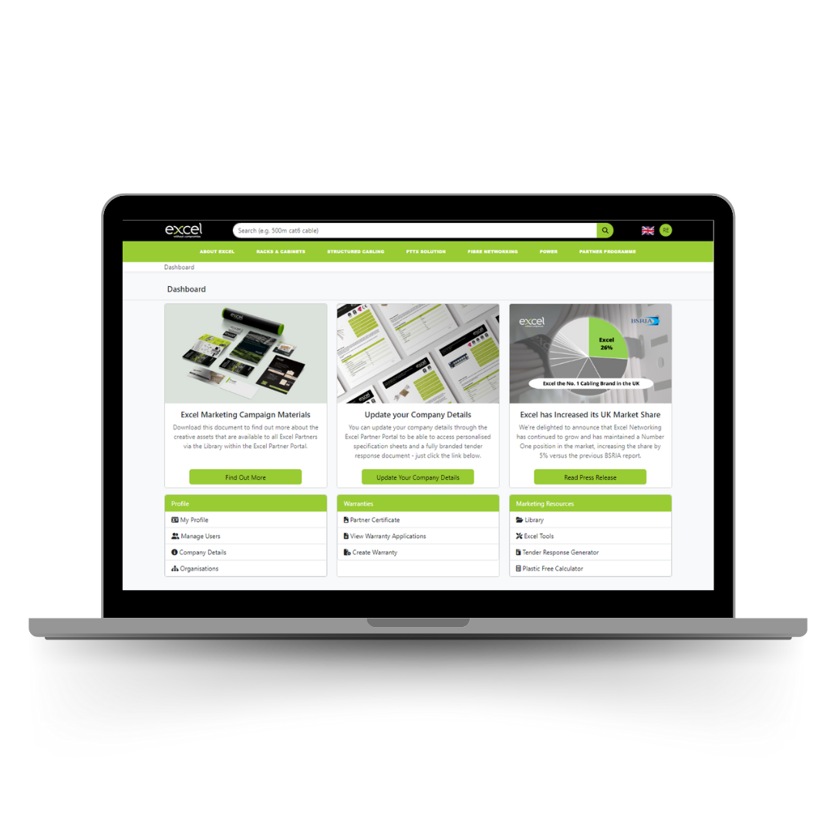
Excel Partner Area
New and improved Warranty Portal
Warranty application history
Comprehensive selection of marketing campaign materials
Access to Excel's Tender Response Generator
Access to Excel's Plastic Free Calculator
Your Excel Partner certificate

Slide 20

Support and Resources

Slide 21



How We Support You
Experts with RCDD qualifications
Product demonstrations
Client facing presentations
Tender response support
Commercial support
Online accreditation training
2-Day accreditation course
Sales and positioning briefings
On-site Toolbox Training
Experts with RCDD qualifications
Installation testing
Site audits

Slide 22
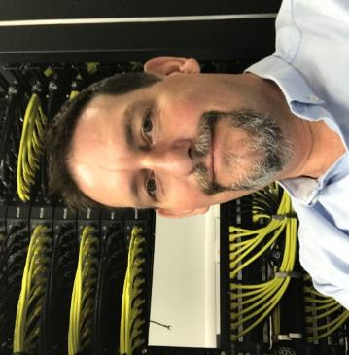
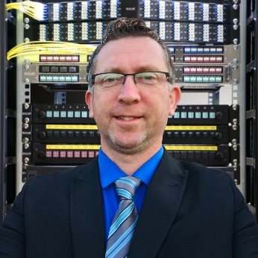
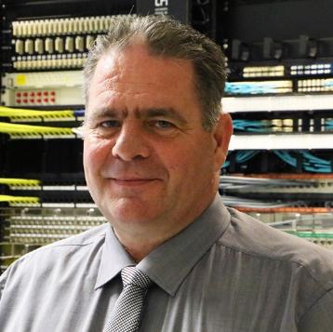
Technical Support
Ian McKiernan
Technical Pre-Sales Manager
+35 years’ industry experience
Member of BSI TCT/007/01 Telecommunications - Installation requirements - Cabling infrastructure, design, planning and commissioning
Accreditations:
  Fluke Versiv CCTT
  CNCI
  CDCTP
  CDCDP
  DCF
  COPT
Responsibilities:
  Supporting customers with pre- and post sales enquiries
  Creating Technical Notes
  Managing warranty applications
Simon Jacobs
Excel Product Manager – Copper & Racks
+20 years industry experience including Audio Video
Career began in aerospace design at Airbus
Responsibilities:
  Product Management for Copper, Cabinets and Power
  Supporting UK, International and Middles East sales teams on projects
  Product Development for Copper, Cabinets and Power
  Writing and maintaining staff product training
  Supporting development of sustainability solutions
Neil Payne
Excel Product Manager – Fibre
+32 years’ industry experience, covering installation of copper, project management, purchasing, sourcing and fibre optic product management
Responsibilities:
Product overviews
Product training
Product development through design or modification

Slide 23
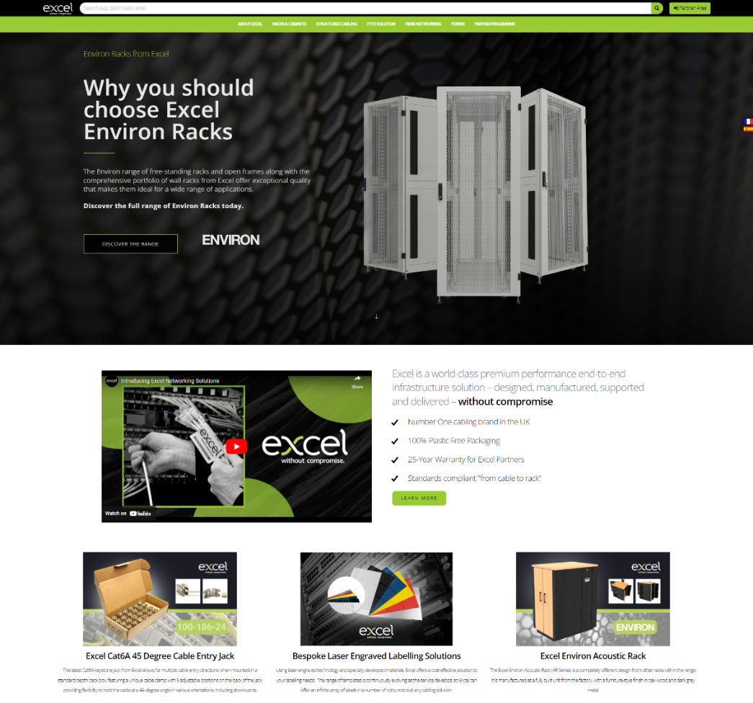




Excel Website | www.excel-networking.com
In depth information about core product categories
  Copper
  Enbeam Fibre
  Environ Racks
  Power
Access to all downloads and resources
  Specification sheets
  Third Party Verification Certificates
  DOP Certificates
  Certificates of Conformity
  Excel Encyclopaedia
  Catalogues and Brochures
  Infographics
  Whitepapers
  Case Studies and Reference Sites

Slide 24
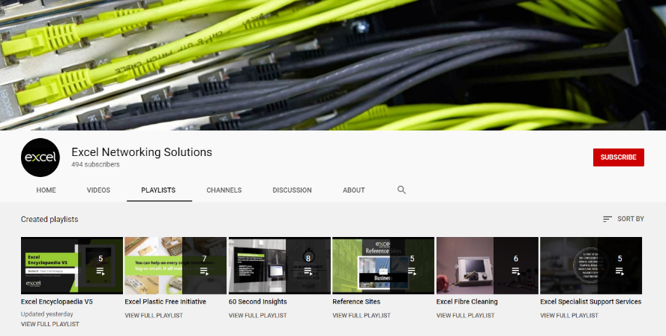

Excel Videos
Subscribe for updates!
A number of videos available on our Youtube Channel
@ExcelNetworking
  “How To” Videos
  “Excel Explains” Webinars
  Reference Sites
  60 Second Insights
  Services overviews
  Product related support
  Excel Encyclopaedia V5

Slide 25
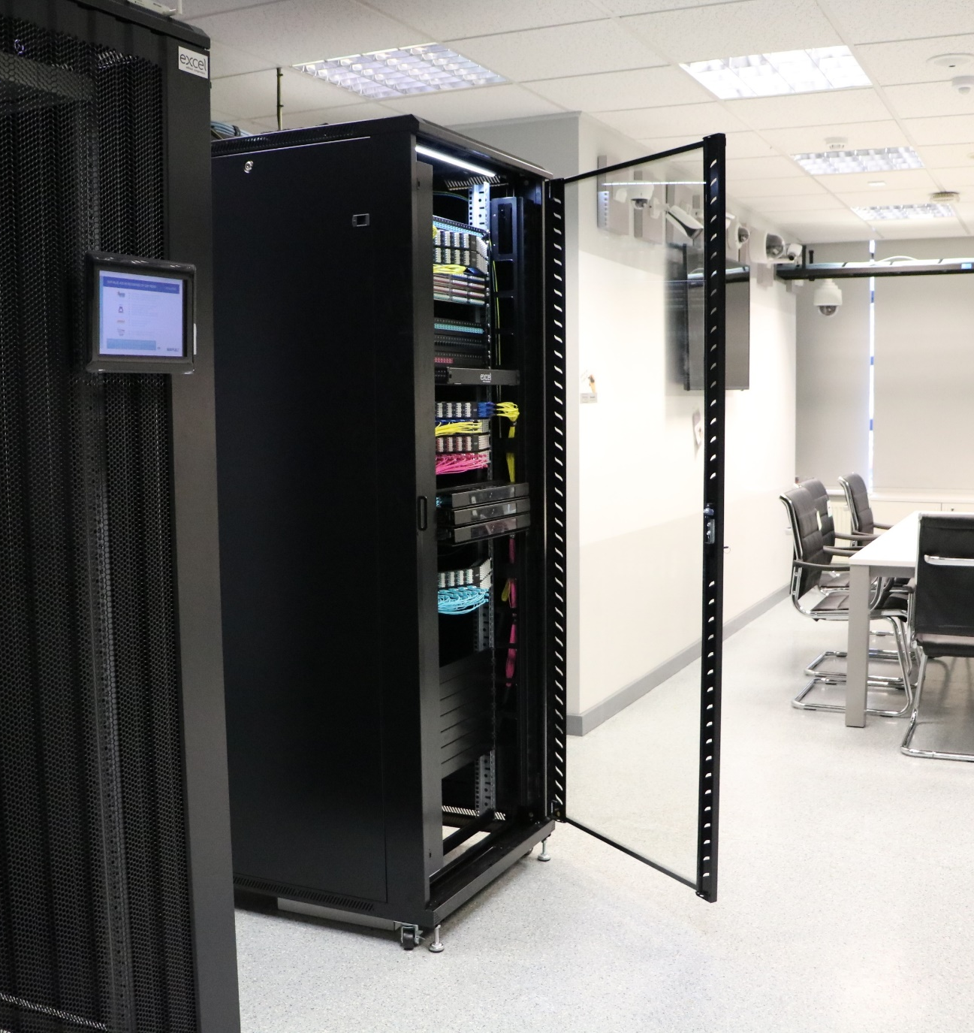
Product Portfolio

Slide 26
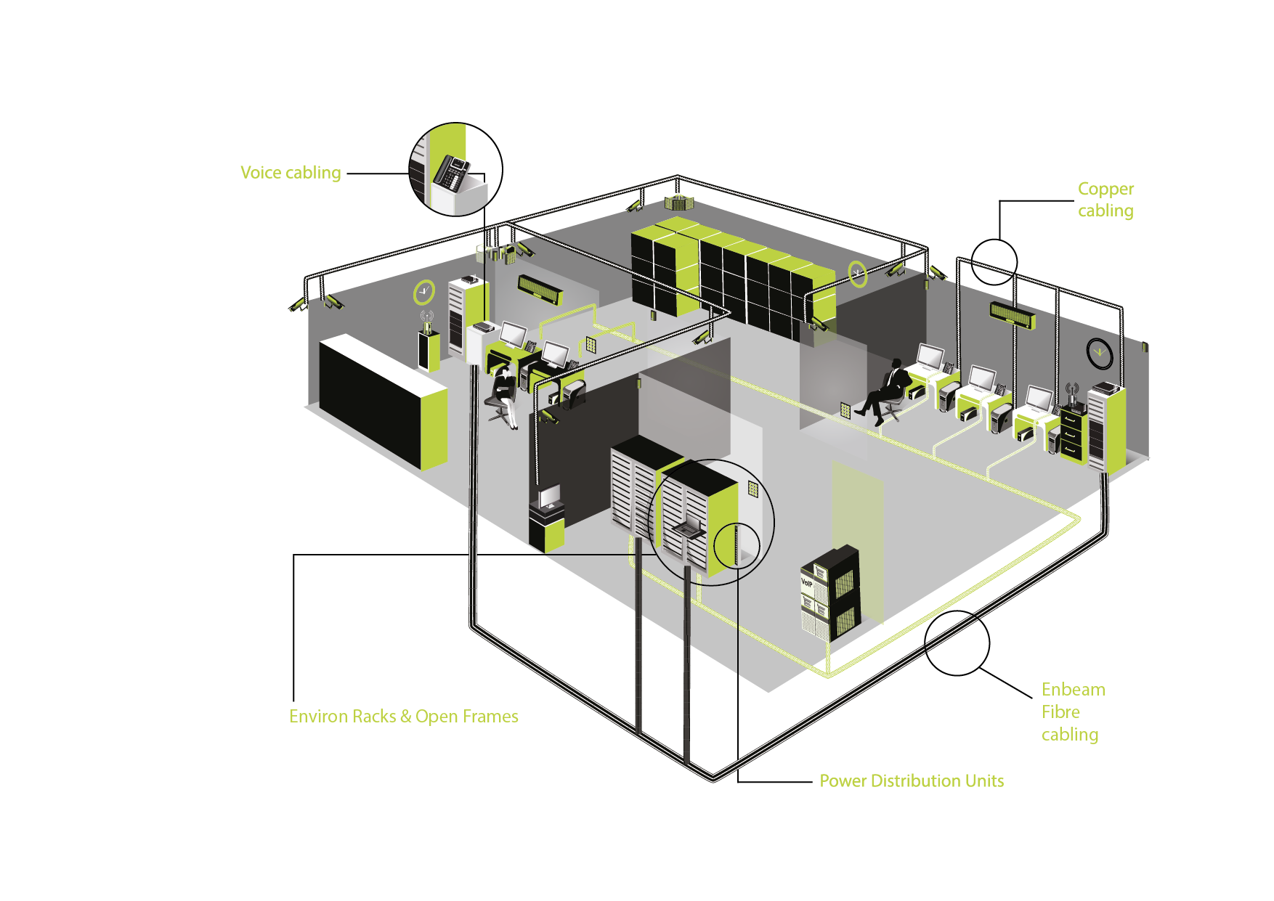
System Offering
Copper
Category 5e U/UTP and F/UTP
Category 6 U/UTP and F/UTP
Category 6_{A} U/UTP, U/FTP and F/FTP
Category 7_{A} S/FTP
Category 8 S/FTP
Pre-Terminated Solutions
Voice
Internal Grade Cabling
External Grade Cabling
Enbeam Fibre
Enbeam Internal/External Grade Cable
Enbeam Patch Cords and Pigtails – ST, SC, LC
Enbeam Connectors and Adaptors
Enbeam Patch Panels
Excelerator Pre-terminated Solutions
Enbeam MTP High density systems
Enbeam FTTx Solutions
Racks
Environ CR (Comms) Racks
Environ ER (Equipment)
Environ SR (Server) Racks
Environ OR (Open) Racks
Environ WR (Wall Mount) Racks
Environ AR (Acoustic) Racks
Environ DCR (Data Centre) Racks
Environ EXR (External) Racks
PDUs
Desktop, Standard and Intelligent

Slide 27

Converged IP Solutions

Slide 28

New Products
Regular New Product Flyers released online, detailing highlights and key features of products recently added to the portfolio
https://excel-networking.com/
downloads/product-updates
Click here to access New Product Flyers online

Slide 29
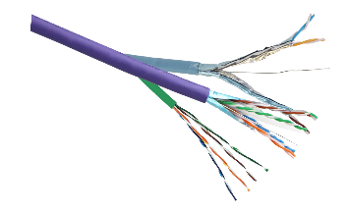
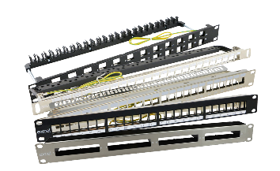

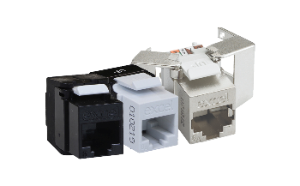
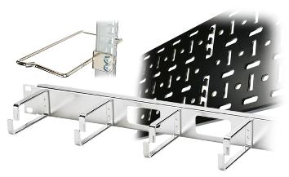
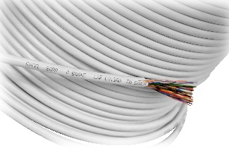
Excel Copper Systems
Copper Cable
Compliance & Performance, built in.
Patch Panels & Frames
High Density & Flexibility, built in.
Patch Leads
Connectivity & Choice, built in.
Jacks, Outlets & Mounting Hardware
Simplicity & Style, built in.
Cable Management
Protection & Control, built in.
Voice Cabling
Clarity & Communication, built in.
www.excel-networking.com/copper

Slide 30

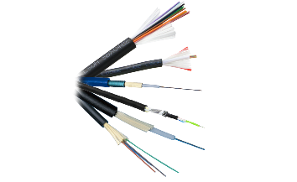
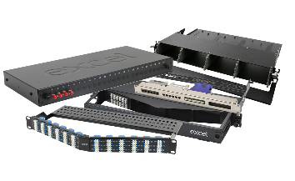
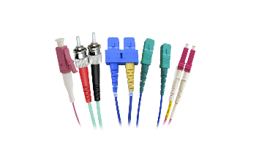
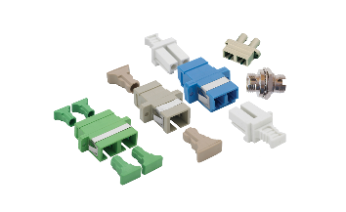
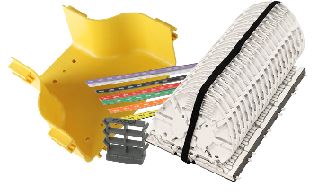
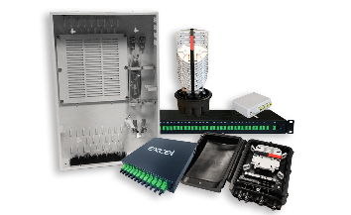
Excel Enbeam Fibre Systems
Fibre Cable
Speed & Performance, at the core.
Patch Panels
Design & Innovation, at the core.
Patch Leads & Pigtails
Quality & Flexibility, at the core.
Adaptors & Connectors
Choice & Precision, at the core.
Fibre Accessories
Control & Protection, at the core.
FTTx Solutions
Futureproof and Simplicity, at the core.
www.excel-networking.com/fibre

Slide 31

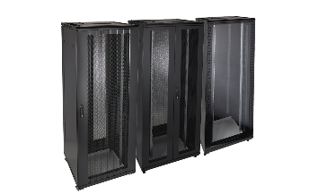
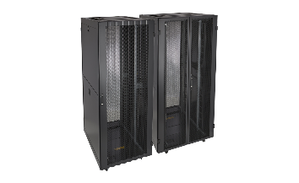
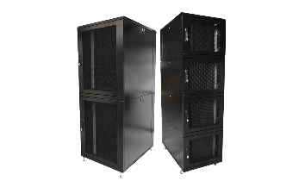
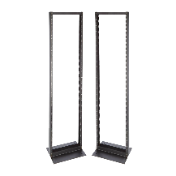
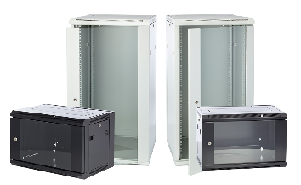
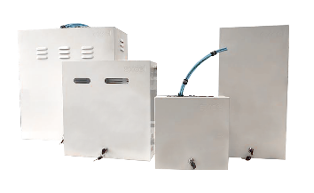
Excel Environ Rack Solutions
Equipment & Communications Rack
Reliable & Dependable, by design.
Server Rack
Strong & Heavy-Duty, by design.
Co-Location Rack
Safe & Secure, by design.
Open Rack
Flexible & Adaptable, by design.
Wall Rack
Ergonomic & Versatile, by design.
Residential Enclosures
Discreet & Multi-Functional, by design.
www.excel-networking.com/environ-racks

Slide 32
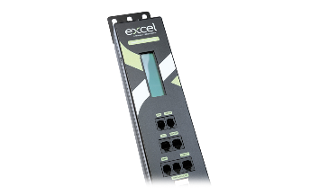
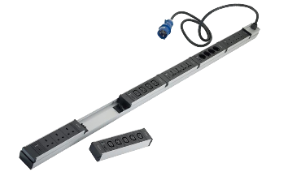
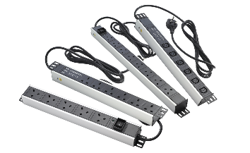
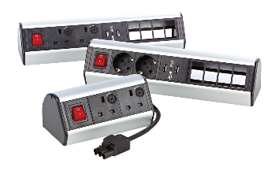
Excel Power Solutions
Intelligent PDUs
Knowledge & Visibility, assured.
Modular PDUs
Interchangeability & Flexibility, assured.
Standard PDUs
Choice & Quality, assured.
Desktop PDUs
Convenience & Accessibility, assured.
www.excel-networking.com/power

Slide 33
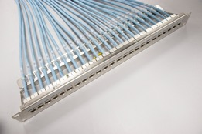
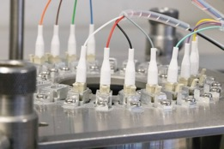


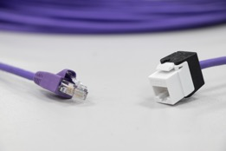
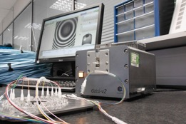




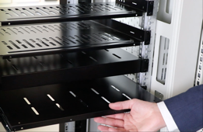

Specialist Support Services
Pre-Terminated Copper Assemblies
With 'plug and play' functionality you can save both time and cost on your copper installations.
Maximises cable usage
Environmentally friendly - reduces waste onsite
Fully tested and fully traceable
Pre-Terminated Fibre Assemblies
For maximum efficiency during fibre installations, opt for one of our pre-terminated fibre offerings.
Bespoke lengths to suit your application
Quality-checked to ensure best performance
Available in a variety of core counts
On-Site Cabinet Assembly & Pre-Configured Racks
Our cabinets can be delivered flat-packed and installed by our experienced team with a full inspection and handover. Alternatively, your Environ solutions can be pre-configured and delivered to site with your required items pre-installed.
Any extra accessories can be fitted as required
Save time for your own installation team
Convenient for space-restrictive sites
Products include PDUs, trays, shelves, locks and more
Fast turnaround
25-year Excel warranty*
Bespoke Product Labelling
For a professional finishing touch, our labelling services allow you to tailor products to your requirements.
Labelling from the moment of installation
Save valuable time on-site
Fade proof acrylic for quality and reliability
www.excel-networking.com/specialist-support-services

Slide 34

FOLLOW US
@excel-networking-solutions

